Slide 1
Transcriptome analysis
Rui Benfeitas, PhD
Science for Life Laboratory
KTH – Royal Institute of Technology
rui.benfeitas@gmail.com
rui.benfeitas@scilifelab.se

Slide 2
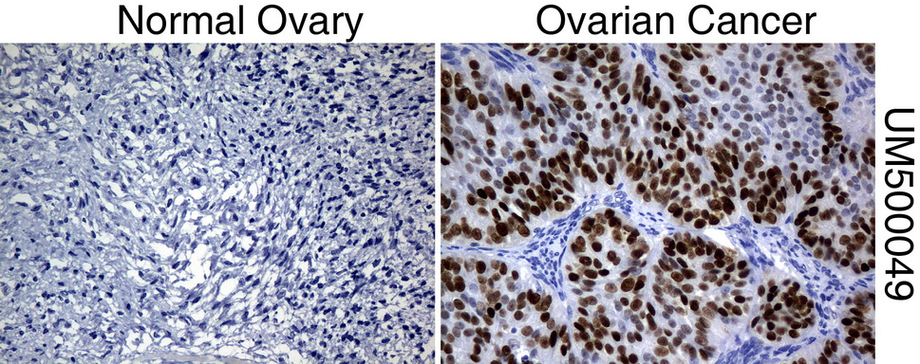
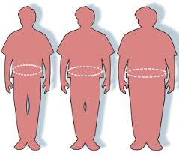
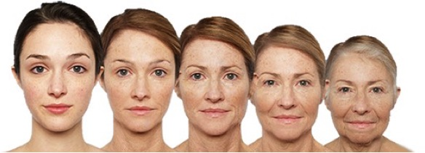
Introduction to gene expression analysis
What to do when you want to compare conditions?

Slide 3
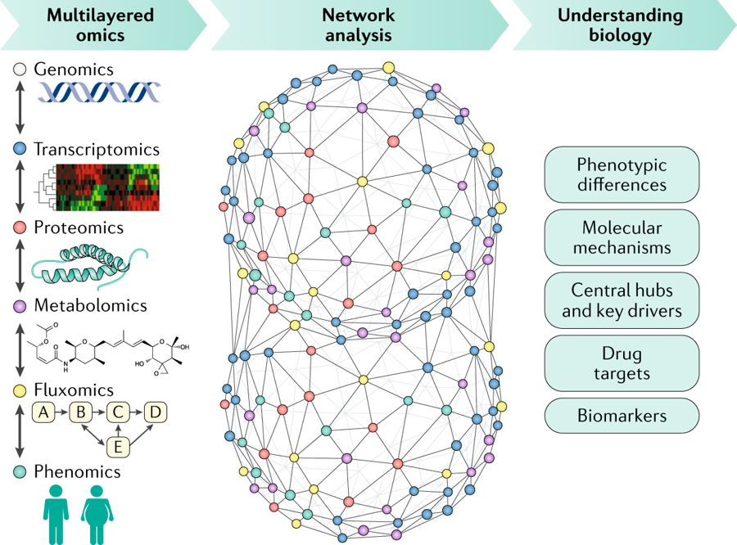
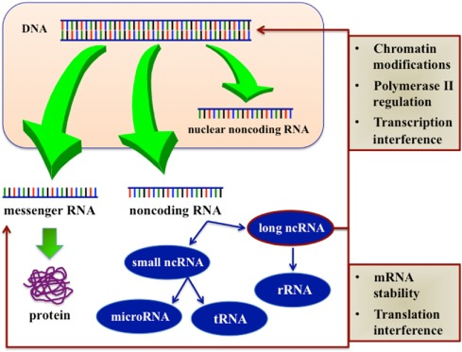
Introduction to gene expression analysis
What to do when you want to compare conditions?
Different layers of analysis
Central dogma
What is the transcriptome?
Focus:
20,000 protein-coding genes (Humans)
How to analyze gene expression data to compare between samples?

Slide 4

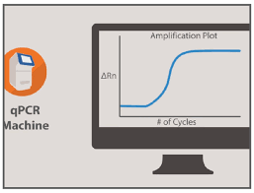
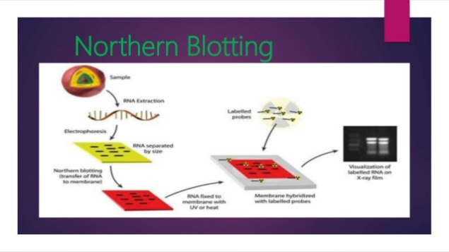
Introduction to gene expression analysis
Possible approaches:
Fluorescent labeling (GFP)
qPCR
Limited to a gene subset
Small scale
Aims:
Measure expression of all (20,000) coding genes
Identify genes significantly different between conditions
Find functional patterns
Identify genes showing coordinated expression
Find biomarkers

Slide 5
Introduction to differential expression analysis
Differential expression analysis
Identify genes significantly altered between conditions
(Over-expressed vs Under-expressed)
How?
Average gene fold change?
Standard statistics? (t-test?)
Specialized methods that control for high # of tests?

Slide 6
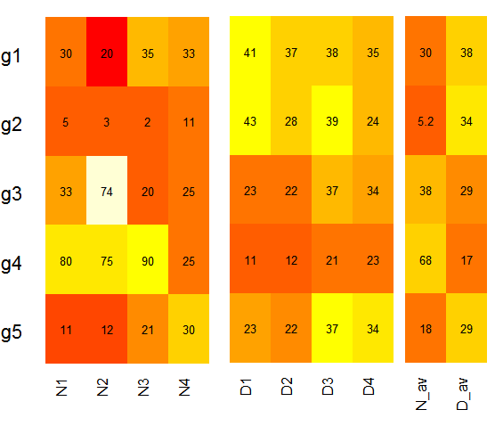
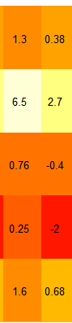
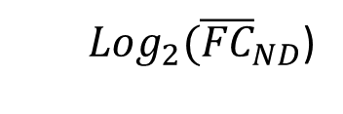
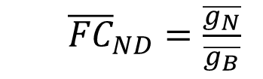
Introduction to differential expression analysis
Are differences random?
Are they significant?
FC
LFC
${\overline{FC}}_{ND}=\frac{\overline{g_{N}}}{\overline{g_{B}}}$
Average fold-change
Centered around 0
Negative = downregulated
Positive = upregulated
LFC
${{Log}_{2}(\overline{FC}}_{ND}$)

Slide 7
Introduction to differential expression analysis
0.084
0.004
0.53
0.037
0.12
LFC
P
${\overline{FC}}_{ND}=\frac{\overline{g_{N}}}{\overline{g_{B}}}$
t test
(P < 0.05 means unlikely)
Average fold-change
LFC
${{Log}_{2}(\overline{FC}}_{ND}$)

Slide 8
Introduction to differential expression analysis
0.084 | 0.25
0.004 | 0.02
0.53 | 0.53
0.037 | 0.15
0.12 | 0.25
LFC
P
FDR
Problem of large number of comparisons (20,000):
higher number of “significant” differences (P<0.05) by chance
Multiple hypothesis correction
(Bonferroni, False Discovery Rate, etc.)
t test
Bonferroni: # tests
vs
FDR

Slide 9
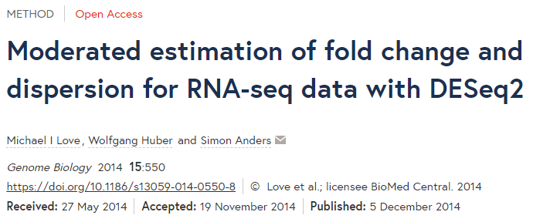
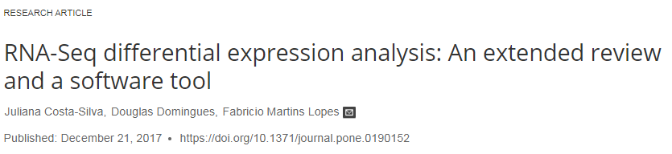
Introduction to differential expression analysis
More sophisticated and accurate approaches are used to compare gene expression profiles
Take into account large number of tests
Capture (statistically) smaller expression differences
Permit comparison between a low number of samples
SAM
Limma
DESeq
EdgeR
Balanced precision, accuracy and sensitivity
CyberT
DESeq2

Slide 10
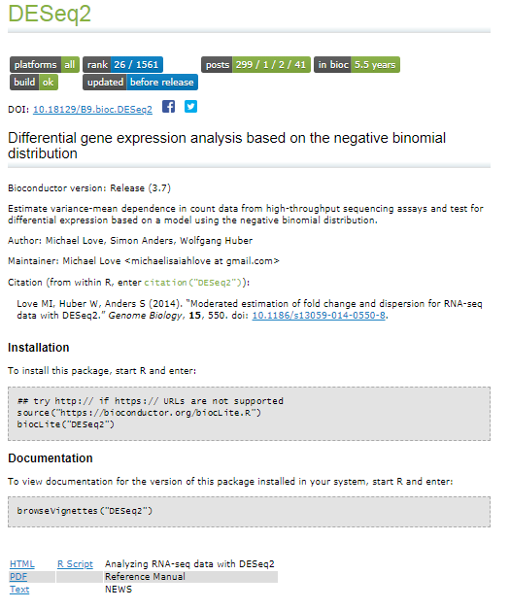
Introduction to differential expression analysis

Slide 11
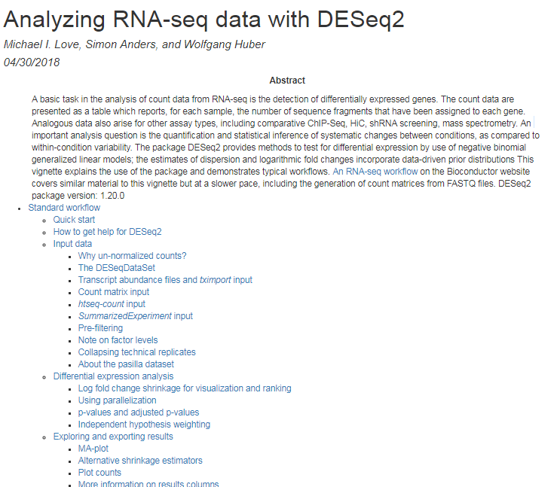
Introduction to differential expression analysis
Details: https://bioconductor.org/packages/release/bioc/vignettes/DESeq2/inst/doc/DESeq2.html

Slide 12
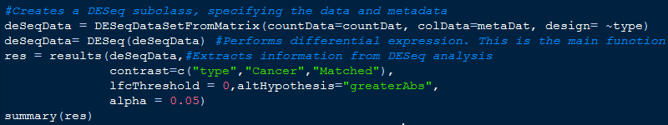
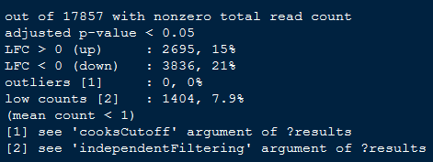
Differential expression analysis with DESeq2
Fits a generalized linear model that takes into account:
Within-group variability (i.e. variability between replicates)
Multiple fitting rounds
Shares information between genes (genes with similar average expression ≈ similar dispersion)
Penalizes genes with lower information (lower expression, higher dispersion, etc.)
Problem with low sample size
Numerator, Denominator
Alternative hypothesis
Null hypothesis
Target FDR
design=~genotype + condition + genotype:condition
Details: https://genomebiology.biomedcentral.com/articles/10.1186/s13059-014-0550-8

Slide 13
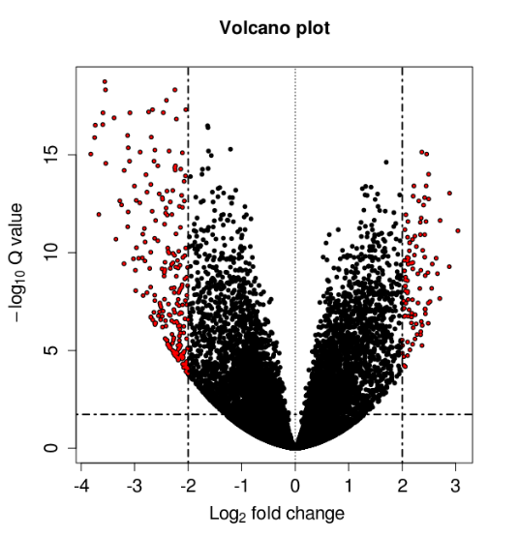
Introduction to Gene Set Enrichment Analysis (GSEA)
You have a list of DEGs: what to do then?
Find common features among DEGs (Biol. Process, subcellular location, etc.)
Count DEGs in known biological processes?
GSEA and signal-to-noise ratio

Slide 14
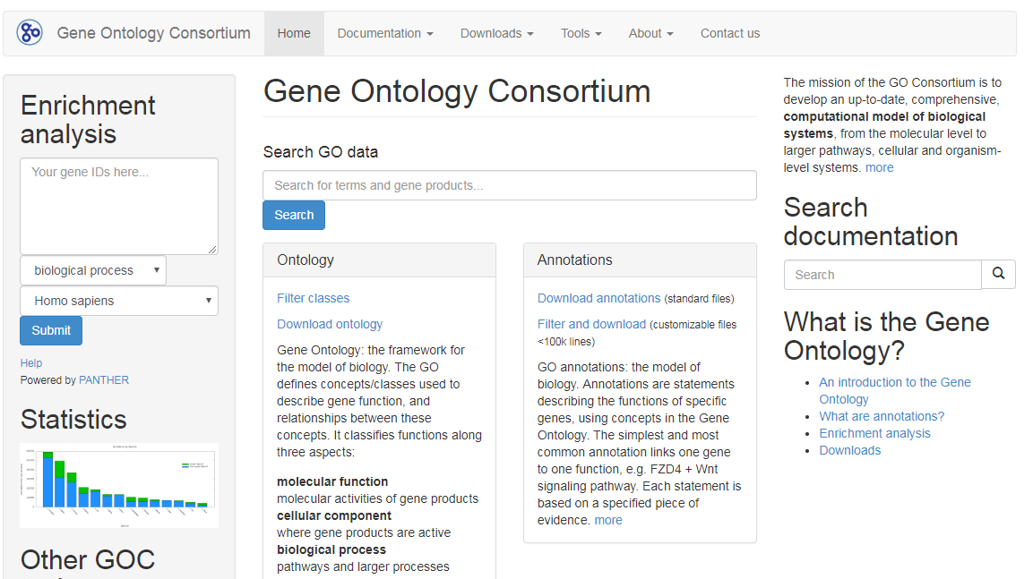
Introduction to GSEA
Attempt to classify and relate genes based on controlled vocabulary
http://geneontology.org/

Slide 15
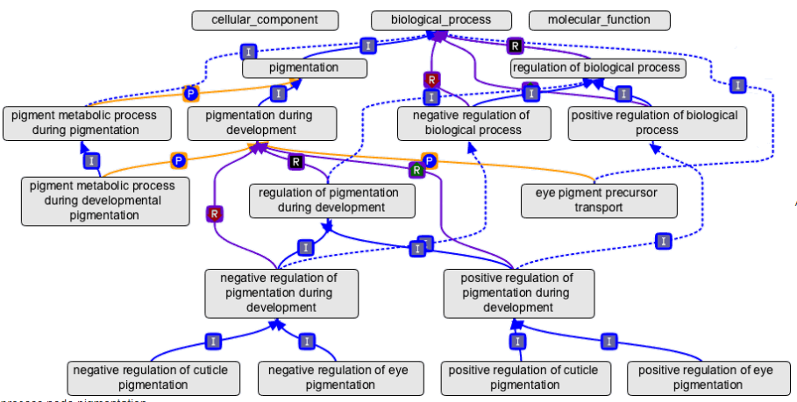
Introduction to GSEA
Careful with tissue of interest
Ontology terms: hierarchical description

Slide 16
Introduction to GSEA
Kolmogorov-Smirnov test
Tests “goodness of fit” for a hypothesized cumulative distribution function
Scores genes present vs absence from a gene set based on a ranked list (DESeq)
CDF of data
Gaussian distribution
H0: Curves are similar
(or differences between curves ~ random walk)
Further reading:
http://stke.sciencemag.org/content/4/190/tr4?ijkey=W33OsCqwQHZ5k

Slide 17
Introduction to GSEA
Popular tools for GSEA:
Reactome
DAVID
Pathwave
GSEA + MSigDB
PIANO
BINGO (Cytoscape)

Slide 18
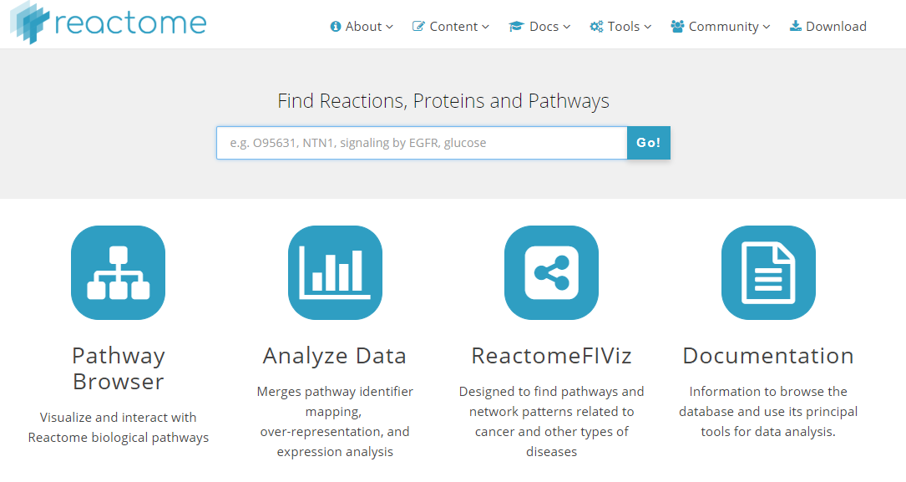
Introduction to GSEA
Popular tools for GSEA: Reactome
https://reactome.org

Slide 19
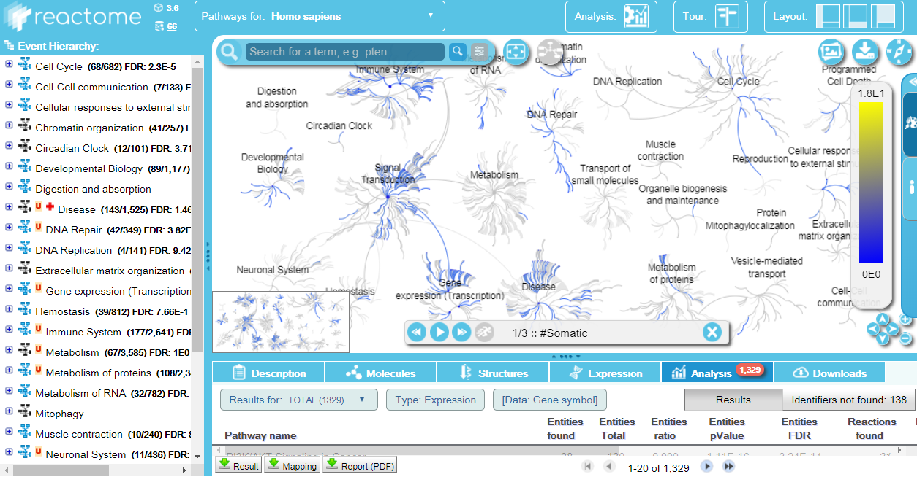
Introduction to GSEA
Popular tools for GSEA: Reactome

Slide 20
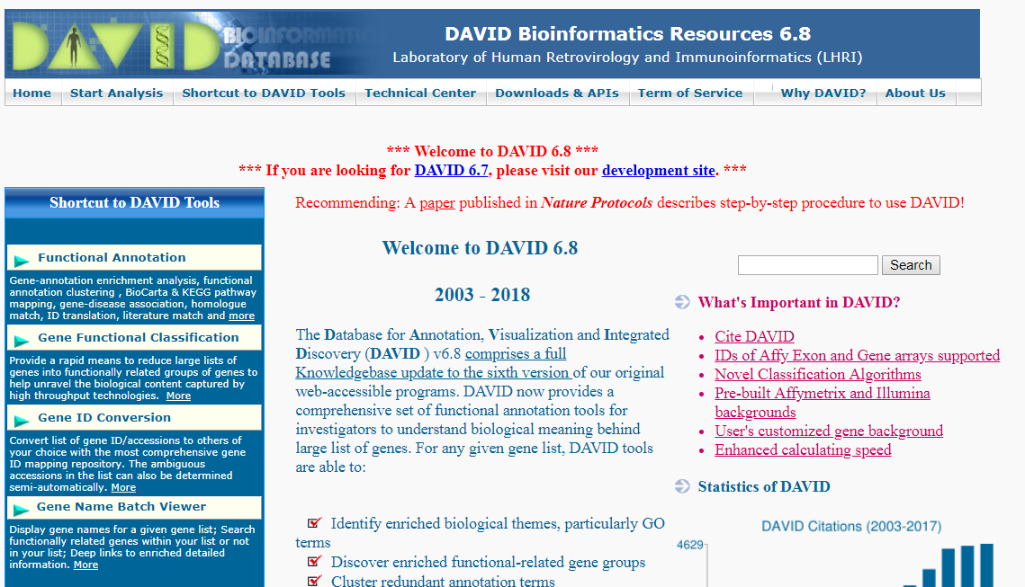
Introduction to GSEA
Popular tools for GSEA: DAVID
https://david.ncifcrf.gov/tools.jsp

Slide 21
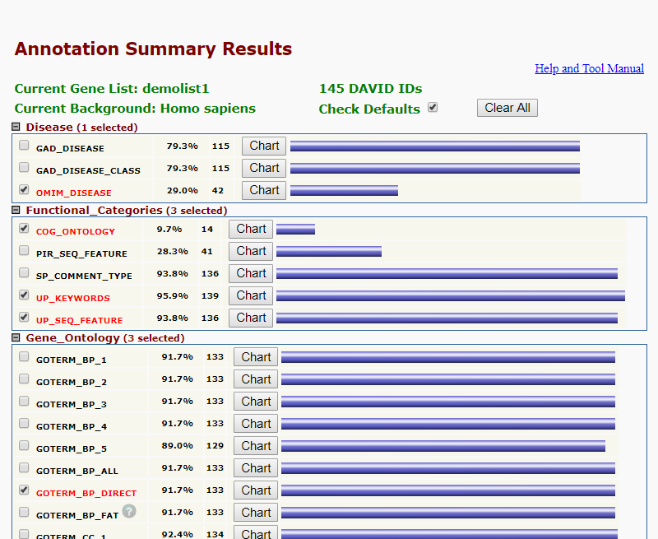
Introduction to GSEA
Popular tools for GSEA: DAVID

Slide 22
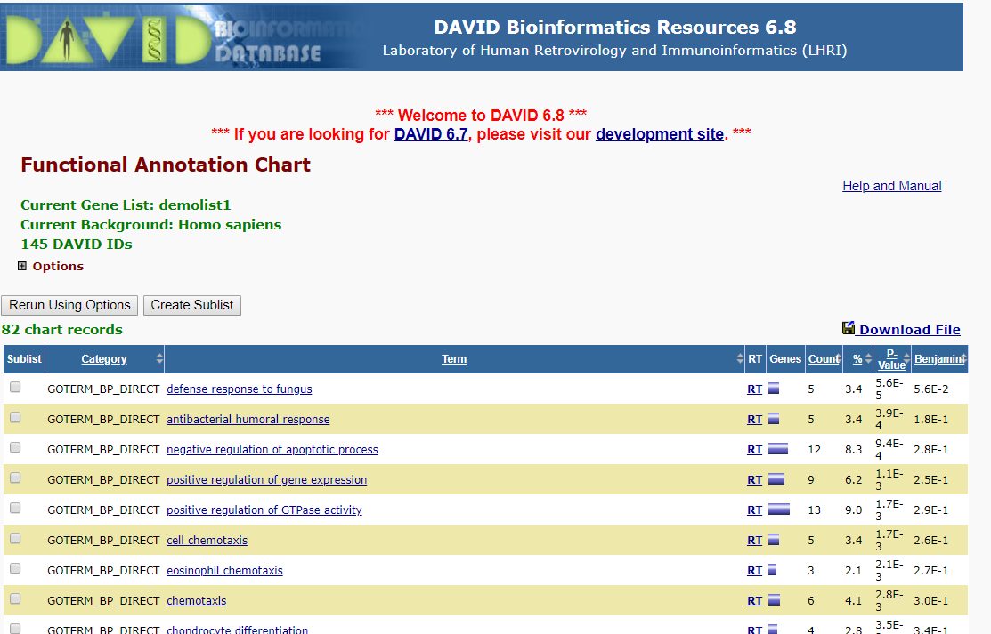
Introduction to GSEA
Popular tools for GSEA: DAVID
Careful: directionality is not present in DAVID
Selection of the background is important

Slide 23
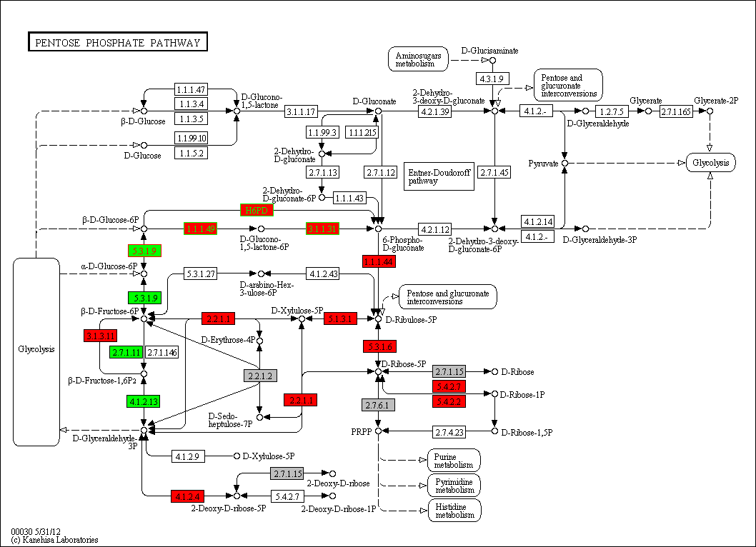
Introduction to GSEA
Popular tools for GSEA: Pathwave
KEGG database
DN
UP
https://www.leibniz-hki.de/en/pathwave.html

Slide 24
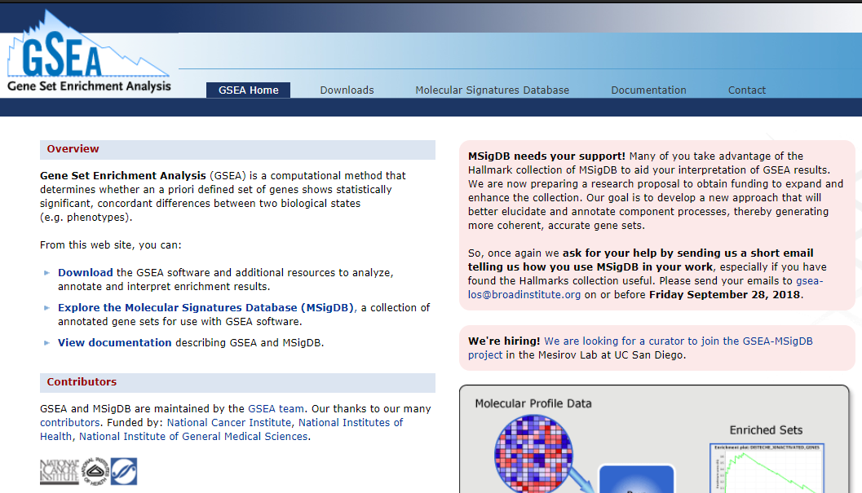
Introduction to GSEA
Popular tools for GSEA: GSEA
http://software.broadinstitute.org/gsea/index.jsp

Slide 25
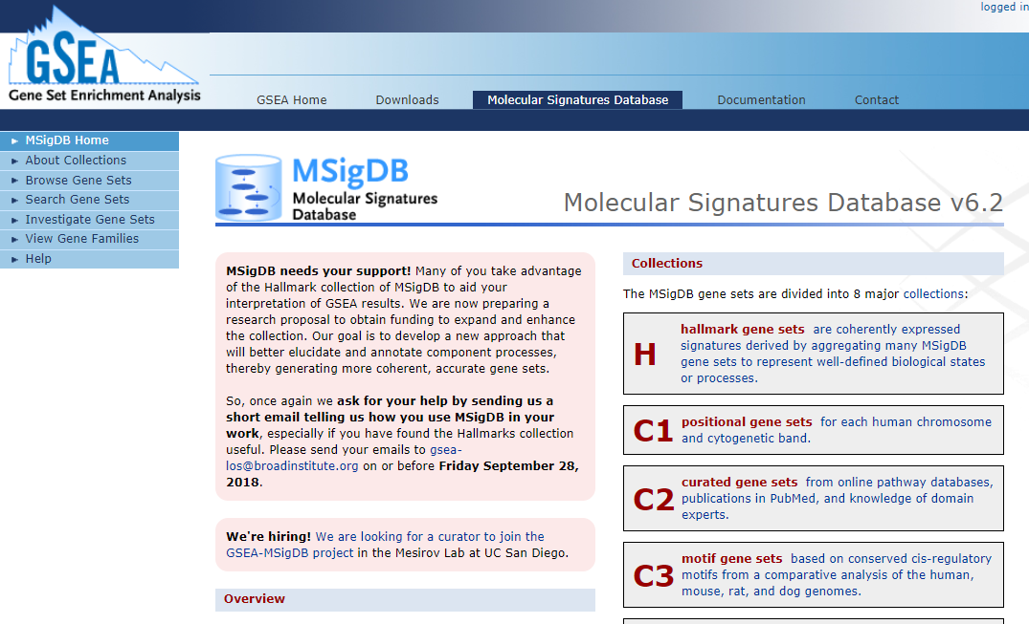
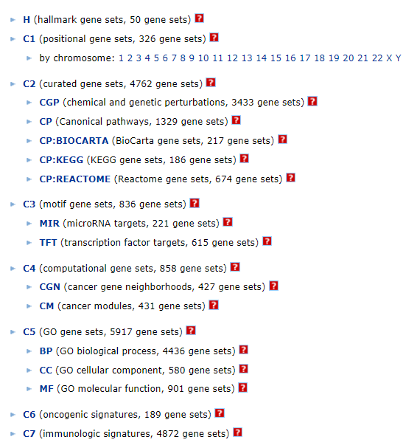
Introduction to GSEA
Popular tools for GSEA: MSigDB
http://software.broadinstitute.org/gsea/msigdb/index.jsp

Slide 26
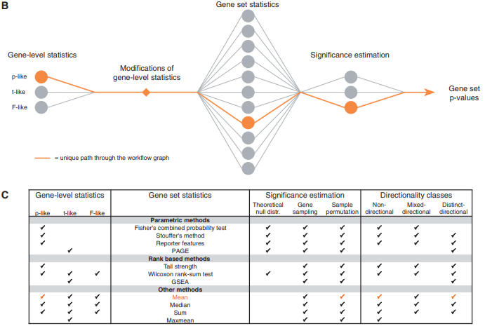
Introduction to GSEA
Popular tools for GSEA: PIANO
Input: gene-level statistics (from DESeq)
Input: gene to gene_set mapping
https://www.ncbi.nlm.nih.gov/pmc/articles/PMC3632109/

Slide 27
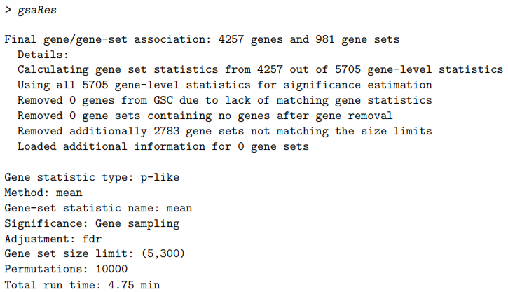
Introduction to GSEA with PIANO

Slide 28
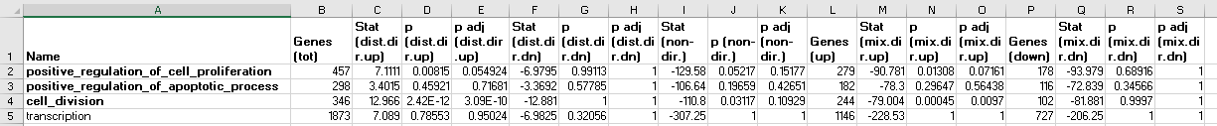
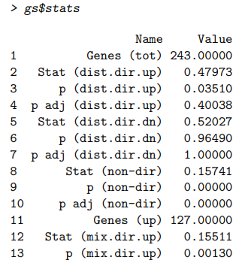
Introduction to GSEA with PIANO
non-directional: disregards direction and uses absolute values of gene-level statistics
distinct-directional: takes direction of change, so that gene sets with both significantly up- and down-regulated will cancel out.
mixed-directional: considers up- and downregulated subsets separately

Slide 29
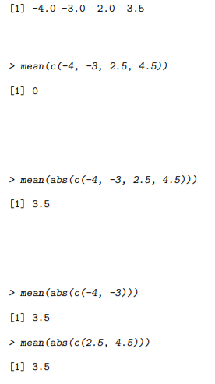
Introduction to GSEA with PIANO
Gene-level statistics
non-directional: disregards direction and uses absolute values of gene-level statistics
distinct-directional: takes direction of change, so that gene sets with both significantly up- and down-regulated will cancel out.
mixed-directional: considers up- and downregulated subsets separately
Distinct-directional
non-directional
mixed-directional

Slide 30
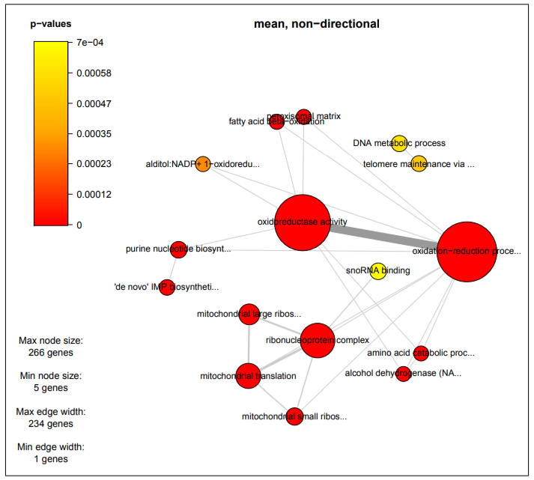
Introduction to GSEA with PIANO
Features several visualization tools
(careful with thick edges)

Slide 31
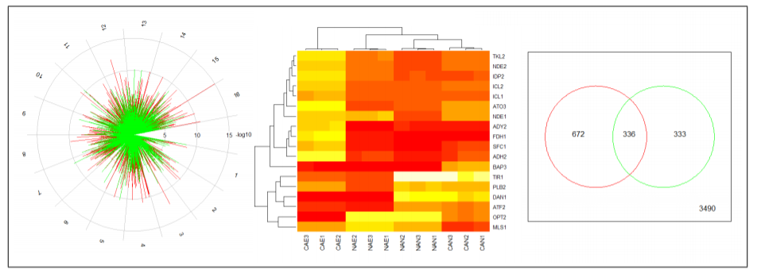
Introduction to GSEA with PIANO
Piano also computes differential expression

Slide 32
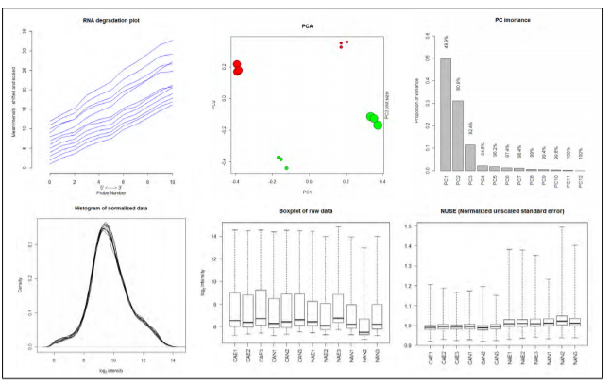
Introduction to GSEA with PIANO
Piano may be used for QC (and normalization)

Slide 33
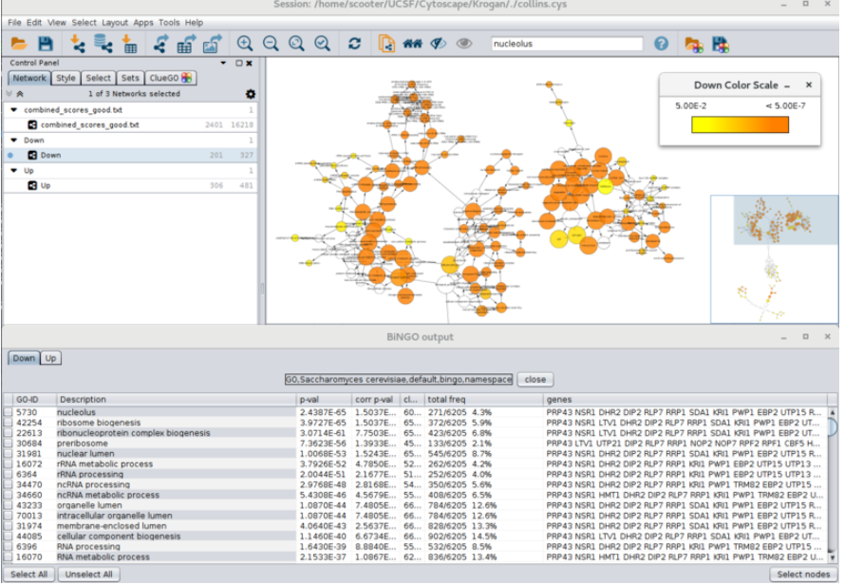
Introduction to GSEA with PIANO
BINGO (Cytoscape)

Slide 34
Introduction to sample clustering
Clustering analysis
Exploratory analyses
Split samples / genes into groups based on similarity
Group large datasets based on similar profiles
Identify co-regulated / functionally related genes
Similarity is identified based on coordinated expression profiles

Slide 35
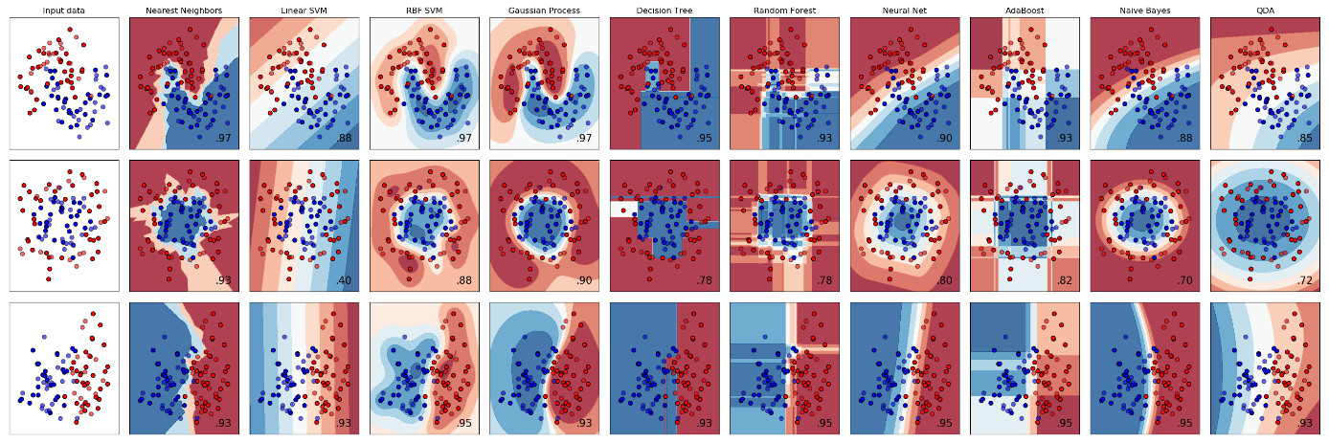
Introduction to sample clustering
Different types of clustering
Unsupervised
Supervised (classification)
Decision trees
Support vector machines
...
Machine learning
Additional reading materials!

Slide 36
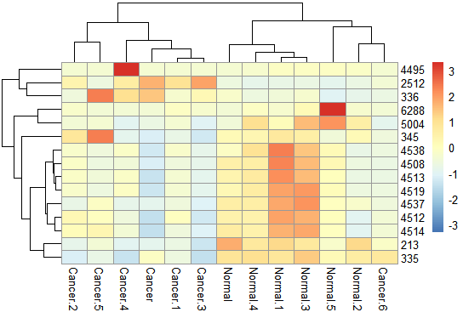
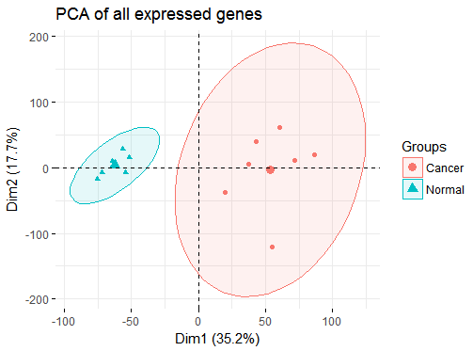
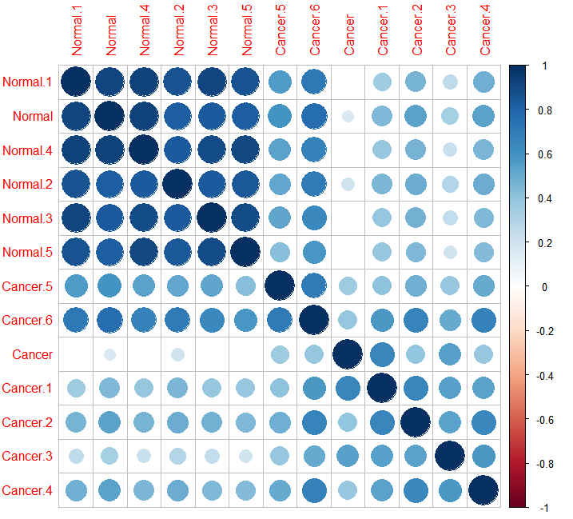
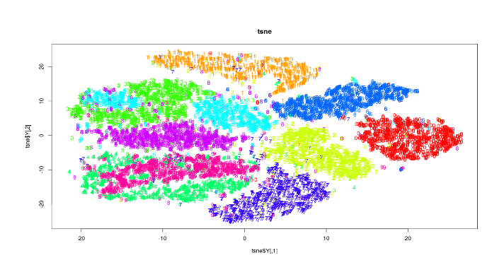
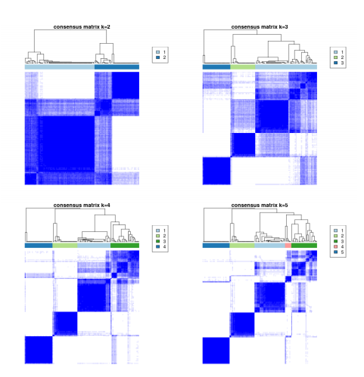
Introduction to sample clustering
Unsupervised clustering
Hierarchical clustering
Principal Component Analysis
Consensus clustering
*tSNE
*Correlation matrices
Others: K-means; K-nearest neighbor; etc.

Slide 37
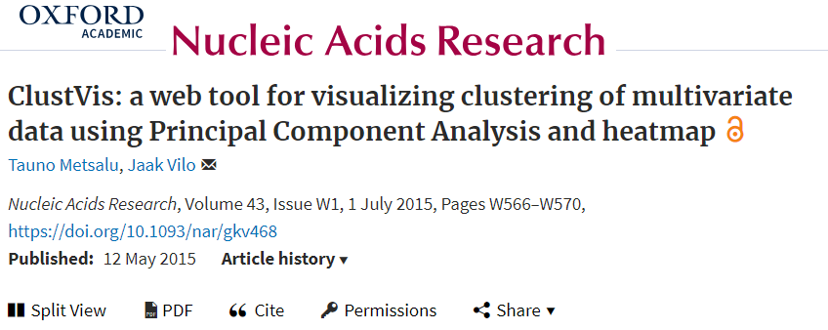
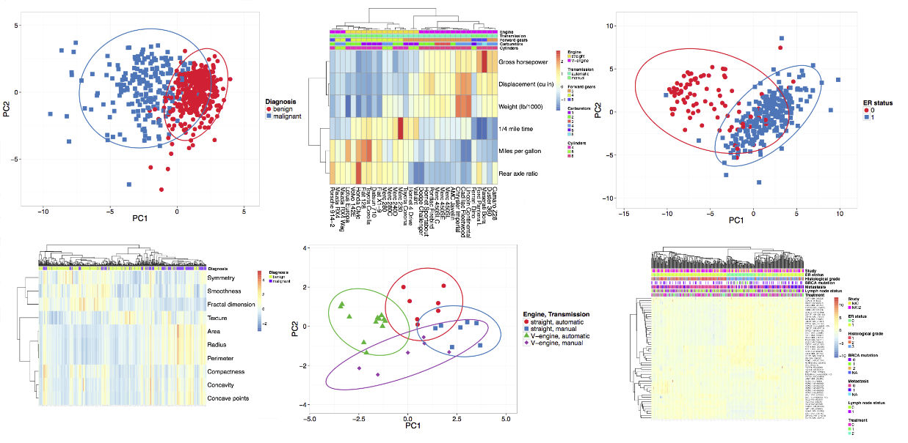
Introduction to sample clustering
https://biit.cs.ut.ee/clustvis/

Slide 38
Introduction to hierarchical clustering
Hierarchical clustering computes similarity between samples.
Challenges in hierarchical clustering
Unknown number of labels / groups
No learning possible
What is correct? How to validate?
General algorithm:
1. Pairwise distances
2. Generate clusters from distance matrix

Slide 39
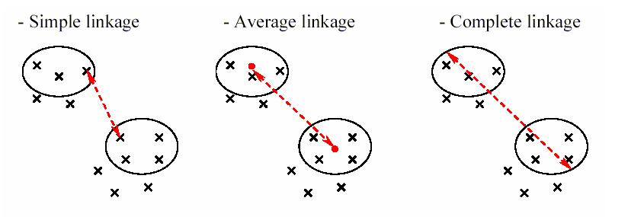
Introduction to hierarchical clustering
Distances (within-group)
Euclidean distance – shortest difference
Correlation (Pearson / Spearman) - trend
...
Linkages (between-group)
Simple
Average
Complete
Ward
...

Slide 40
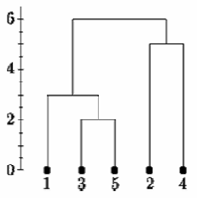
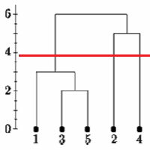
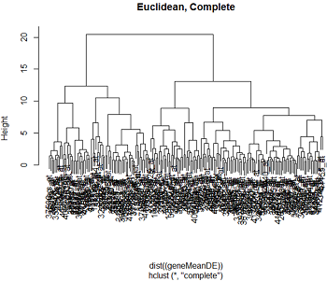
Introduction to hierarchical clustering
Generating clusters may also be done by different approaches:
Agglomerative (bottom-up)
Divisive (top-down)
The problem in finding the correct number of clusters

Slide 41

Introduction to hierarchical clustering
In R:
Genes

Slide 42


Introduction to clustering
Consensus clustering
Combines resampling and machine learning to identify robustly-associated clusters
May be used to represent resampling of other clustering methods
Further reading: https://link.springer.com/article/10.1023/A:1023949509487
https://bioconductor.org/packages/release/bioc/html/ConsensusClusterPlus.html

Slide 43





Introduction to Principal Component Analysis (PCA)
PCA is a dimensionality reduction tool
Identify set of features (Principal Components) that explain the most variance (important to Normalize data)
Preserve large pairwise (linear) distances in the map
Assumptions:
Linearity (also a strength!)
Comparable variance
...
Further reading: https://www.cs.cmu.edu/~elaw/papers/pca.pdf
http://www.cs.otago.ac.nz/cosc453/student_tutorials/principal_components.pdf

Slide 44

Introduction to Principal Component Analysis (PCA)
Mathematical details: https://www.cs.cmu.edu/~elaw/papers/pca.pdf
In R:
13 samples
11,000 genes down to 2 dimensions
Explained variance >55%
95% CI indicated by elipses

Slide 45

t-Distributed Stochastic Neighbor Embedding (tSNE)
Non-linear approach
Minimizes distances within clusters
Does not deal well with high numbers of features (PCA often used prior to tSNE)
Some parameter tinkering
Further reading:
https://lvdmaaten.github.io/tsne/
https://www.analyticsvidhya.com/blog/2017/01/t-sne-implementation-r-python/
https://www.youtube.com/watch?v=RJVL80Gg3lA

Slide 46

Visualization of differentially expressed genes / GSEA

Slide 47

Visualization of differentially expressed genes / GSEA
Biol. processes

Slide 48

Visualization of differentially expressed genes / GSEA
DEGs
Biol. processes
https://cran.r-project.org/web/packages/RCircos/

Slide 49

Visualization of differentially expressed genes / GSEA
https://cran.r-project.org/web/packages/RCircos/

Slide 50

Correlation matrices
Pairwise correlations between samples / genes
Spearman vs Pearson
Significance testing is important
Multiple hypothesis correction

Slide 51

Correlation matrices
Pairwise correlations between samples / genes
Spearman vs Pearson
Significance testing is important
Multiple hypothesis correction
In R:

Slide 52


Clustering and QC
Hierarchical clustering, PCA, and correlation plots are often used in QC
Often, multiple methods are combined to identify robust clusters
E.g. for genes: identify similar biological processes for clustered genes

Slide 53
Additional reading
Tutorial for preprocessing, PCA, and DESeq
https://www.bioconductor.org/help/course-materials/2016/CSAMA/lab-3-rnaseq/rnaseq_gene_CSAMA2016.html
Differential expression analysis
https://genomebiology.biomedcentral.com/articles/10.1186/s13059-014-0550-8
https://journals.plos.org/plosone/article?id=10.1371/journal.pone.0190152
https://bioconductor.org/packages/release/bioc/vignettes/DESeq2/inst/doc/DESeq2.html
https://bioc.ism.ac.jp/packages/2.14/bioc/vignettes/DESeq2/inst/doc/beginner.pdf
Gene set enrichment analysis
http://stke.sciencemag.org/content/4/190/tr4?ijkey=W33OsCqwQHZ5k
Supervised clustering (classification)
https://data-flair.training/blogs/classification-in-r/
https://www.kaggle.com/meepbobeep/intro-to-regression-and-classification-in-r
https://lgatto.github.io/IntroMachineLearningWithR/supervised-learning.html
Hierarchical clustering
https://newonlinecourses.science.psu.edu/stat555/node/85/
PCA
https://www.cs.cmu.edu/~elaw/papers/pca.pdf
http://www.cs.otago.ac.nz/cosc453/student_tutorials/principal_components.pdf
http://www.sthda.com/english/wiki/print.php?id=219
tSNE
https://lvdmaaten.github.io/tsne/
https://www.analyticsvidhya.com/blog/2017/01/t-sne-implementation-r-python/
https://www.youtube.com/watch?v=RJVL80Gg3lA
Correlation plots
http://www.sthda.com/english/wiki/correlation-matrix-a-quick-start-guide-to-analyze-format-and-visualize-a-correlation-matrix-using-r-software
Other useful tutorials
https://www.ebi.ac.uk/training/online/course/functional-genomics-ii-common-technologies-and-data-analysis-methods/biological-0

